Slide 1

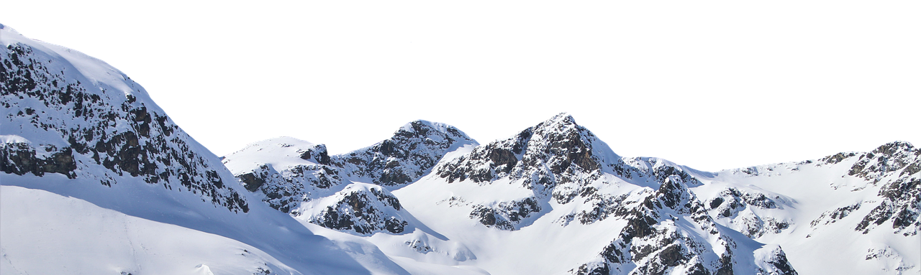

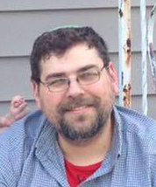
Maximizing Pricing Strategy
One Day – One Adult
Admission
$81.00
Marc Kolb
Data Scientist

Slide 2
Problem Identification
Current Pricing:
Based on Market Average
Not Capitalizing on Premium Facilities
Some Facilities Underutilized
One Day – One Adult
Admission
$81.00

Slide 3
Problem Identification
Data-Based Solution:
Optimize Ticket Pricing
Lower Maintenance Costs
Increase Margin
One Day – One Adult
Admission
$81.00

Slide 4
Recommendations and Key Findings
Recommendations:
Increase Base Ticket Price to $95.87
Close Five of the Least Used Runs
Increase Vertical Drop by 150 Feet
One Day – One Adult
Admission
$103.73

Slide 5

Model Results and Analysis
Exploratory Data Analysis:
Ski Resort Data
Resorts per Capita
Resort Density
Resorts per State
State Data
Resorts per Area

Slide 6

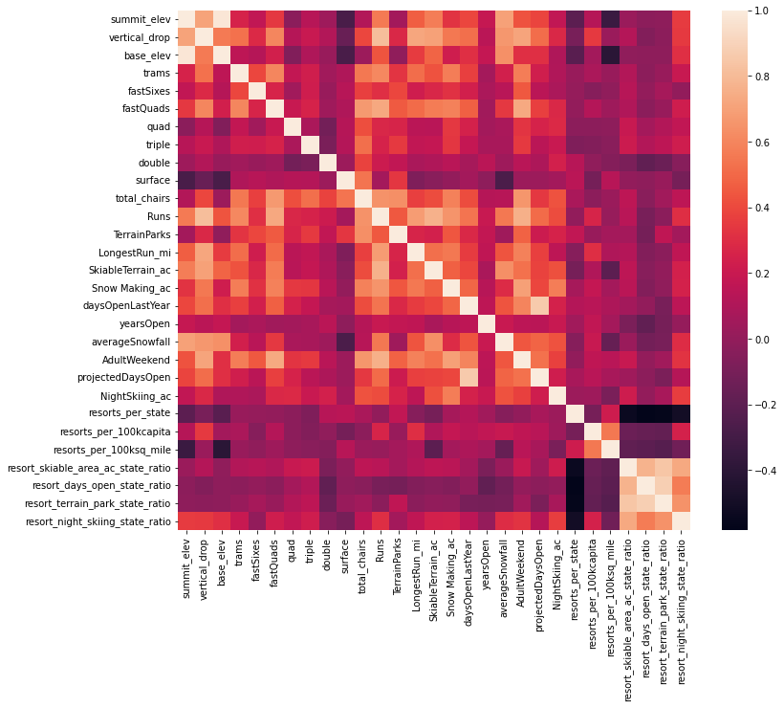
Model Results and Analysis
Feature Correlation (Heat Map):
Relevant Correlations with Ticket Price:
Vertical change in elevation from the summit to the base. (vertical_drop)
Number of fast four-person chairs. (fastQuads)
The number of runs on the resort. (Runs)
Total area covered by snow-making machines. (Snow Making_ac)

Slide 7
Model Results and Analysis
Training the Model With Data:
This data will inform the machine learning model.
Full Compiled Data
This data will test the model for accuracy and error.
Big Mountain Data
Training Data
Testing Data

Slide 8

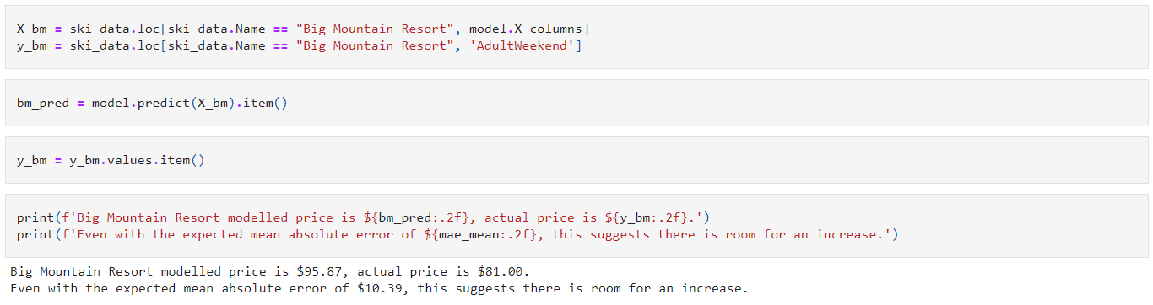


Model Results and Analysis
Using the Machine Learning Model to Predict:
One Day – One Adult
Admission
$103.73
Ticket Price
Value Improvements

Slide 9
Summary and Conclusion:
Recommendations:
Increase Base Ticket Price to $95.87
Close Five of the Least Used Runs
Increase Vertical Drop by 150 Feet
One Day – One Adult
Admission
$103.73

